Slide 1

ADBMS
IFT – 530
Submitted to -
Prof Robert Rucker
Submitted by -
Niharika LNU
Abhilash Nataraja
Namratha Ganesh Chandrashekaraya
Priyanka Menghani
Niharika

Slide 2
Topic of Contents
Introduction
Importance
Design requirements
Workflow
ORM Diagram
Relational Schema
Tables
Stored Procedures
Triggers
NOSQL
Buckets
Summary
Conclusion
Niharika

Slide 3

introduction
Many of us are deeply affected by movies because the combination of pictures, music, conversation, lighting, sound, and special effects may provoke strong emotions and prompt us to reflect on our lives.
Niharika

Slide 4

Movie management system
It aids in the streamlining and automation of all activities, providing you with the ideal management system, allowing you to maintain totalitarian management over all cinema operations.
The cinema management system will aid in keeping track of ticket sales and movie attendance when people purchase tickets.

Slide 5

importance
Reduction of human error
Reduces the amount of manual tasks
Helps you to optimize your operations
Brings consistency in operations.
Niharika

Slide 6
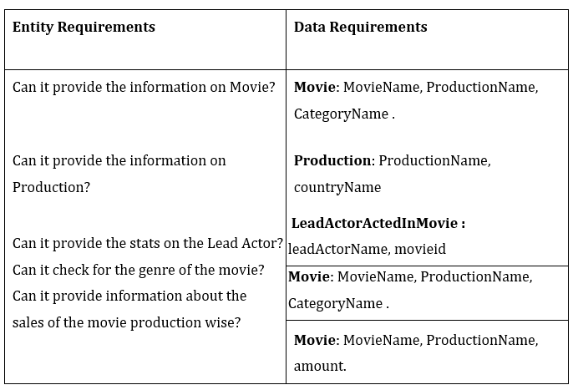

DESIGN REQUIREMENTS
Niharika

Slide 7

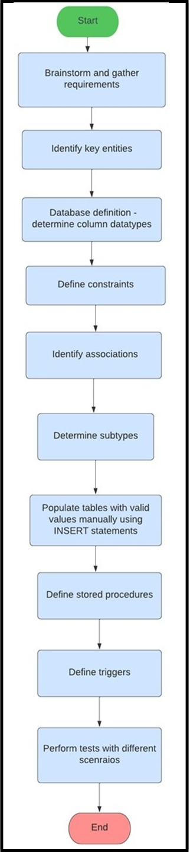

workflow
Niharika

Slide 8
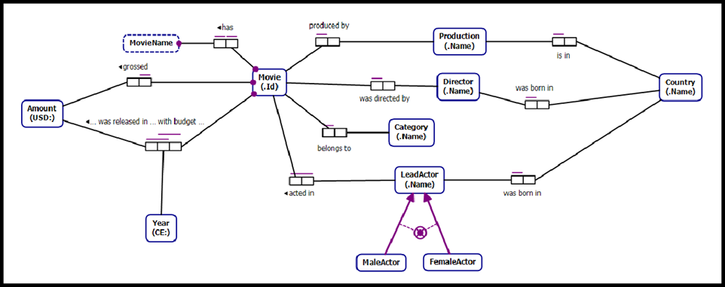
Orm diagram
Niharika

Slide 9
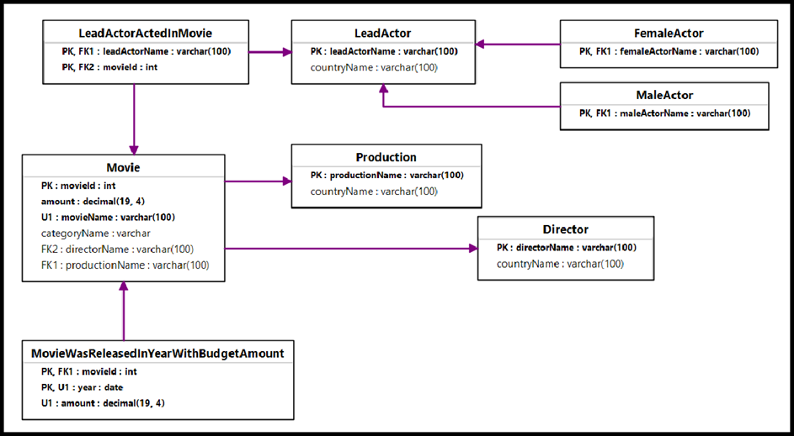
Relational schema
Niharika

Slide 10
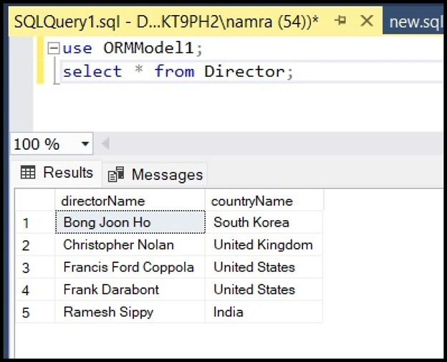
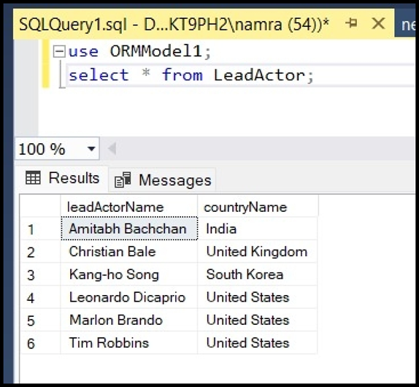
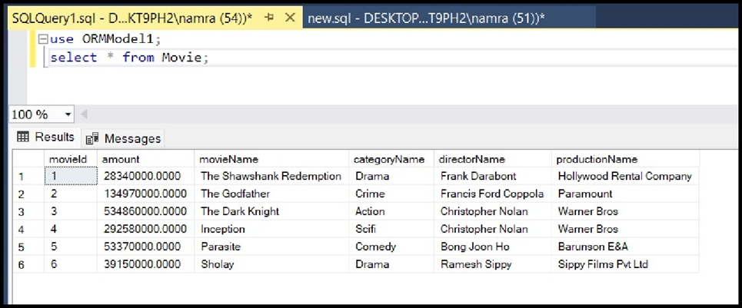
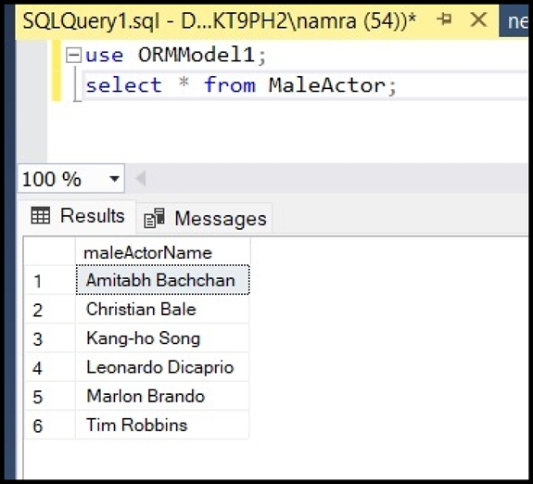
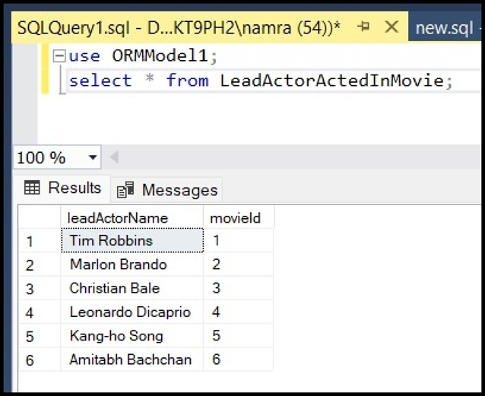
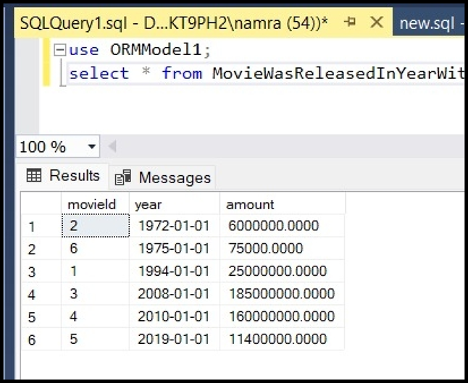
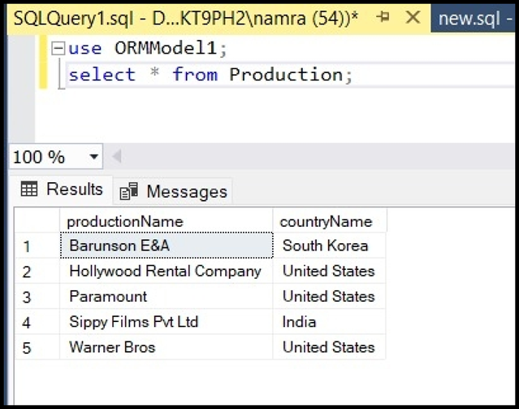
Tables

Slide 11

Stored procedures
Between the user interface and the database, a stored procedure adds an important layer of security. Because end users may enter or edit data but do not develop processes, it promotes security through data access restrictions.
Benefits:
Easily modified
Reduced network traffic
Reusable
Security
Performance

Slide 12
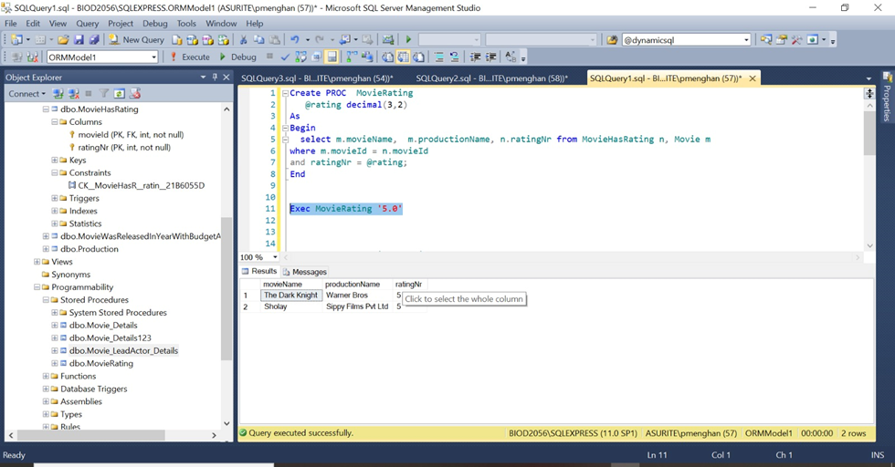
Stored Procedure 1
MovieRating

Slide 13
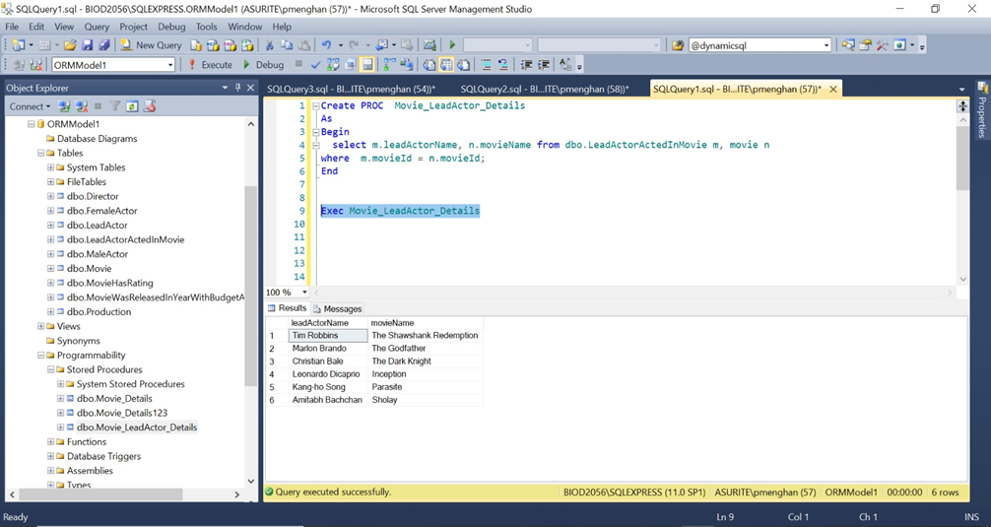
Stored Procedure 2
Movie_LeadActor_Details

Slide 14
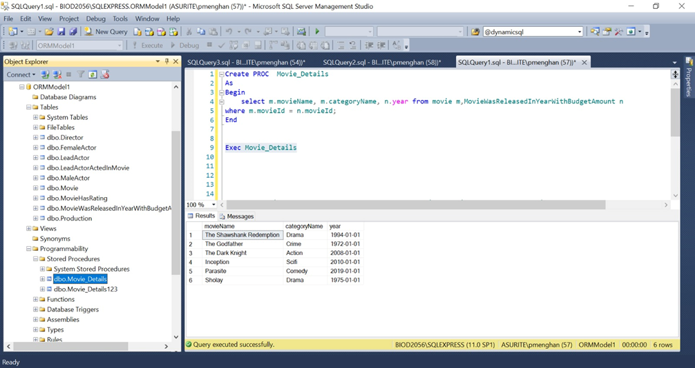
Stored Procedure 3
Movie_Details

Slide 15
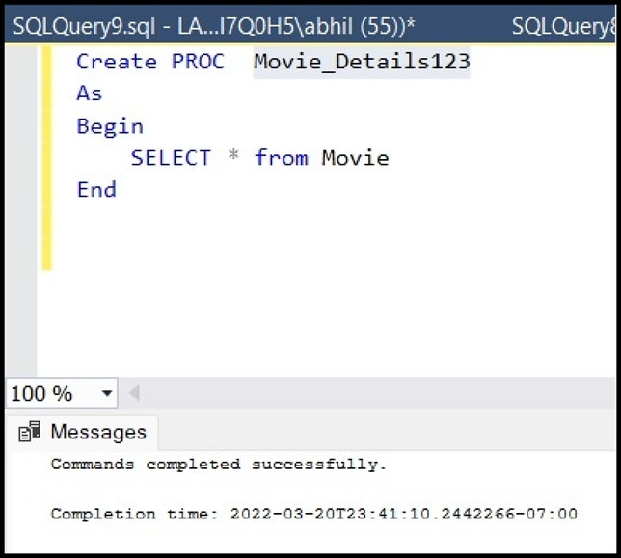
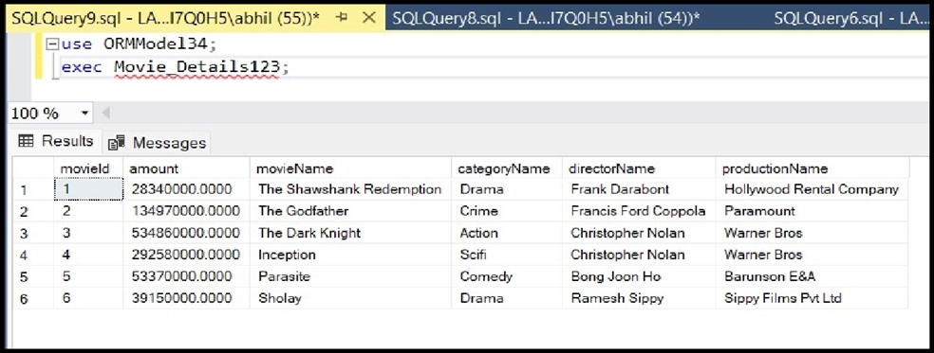
Stored Procedure 4
Movie_Details123

Slide 16
triggers
Triggers allow you to validate the data's integrity. When a change occurs in the database, the triggers might make changes to the whole database. Triggers aid in keeping the User Interface light. Instead of repeating the same function call throughout the program, you may use a trigger to have it run.
We have used 2 triggers :
tgr_movie_INSERT
tgr_movie_neg_rating_INSERT

Slide 17
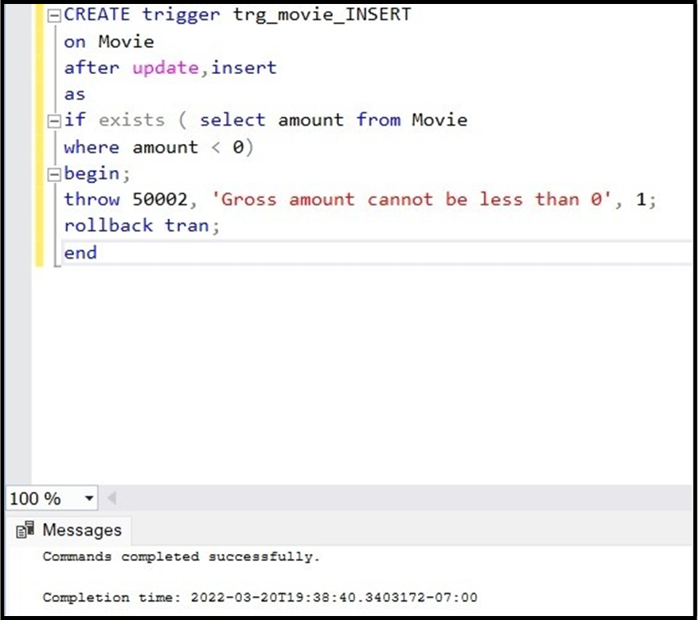
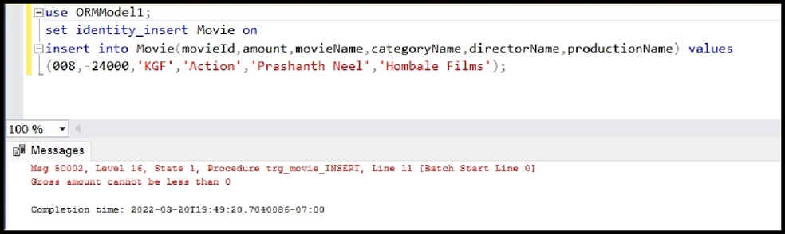
Trigger 1: tgr_movie_INSERT

Slide 18
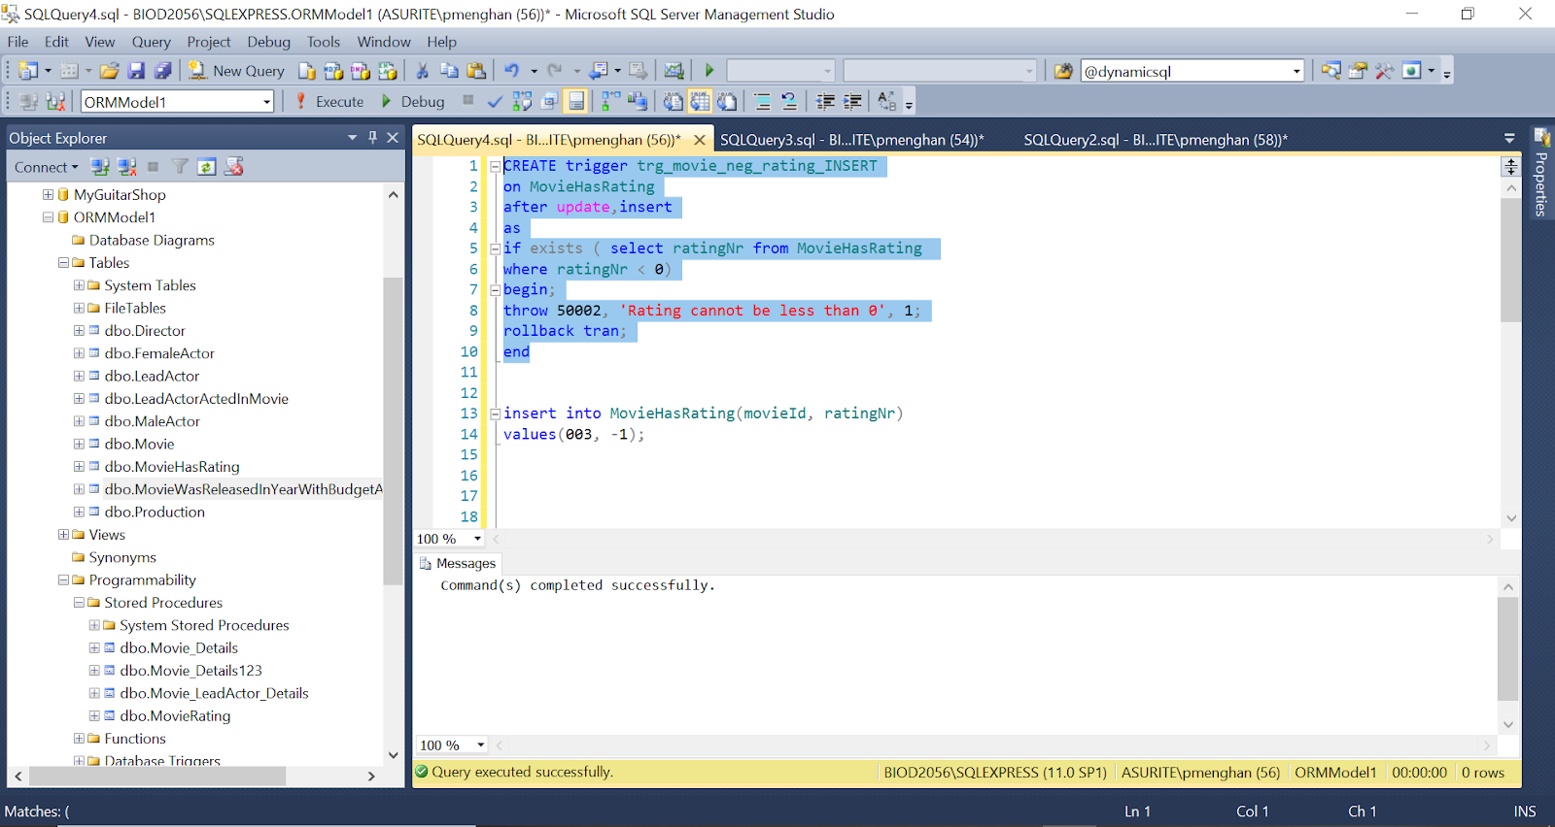
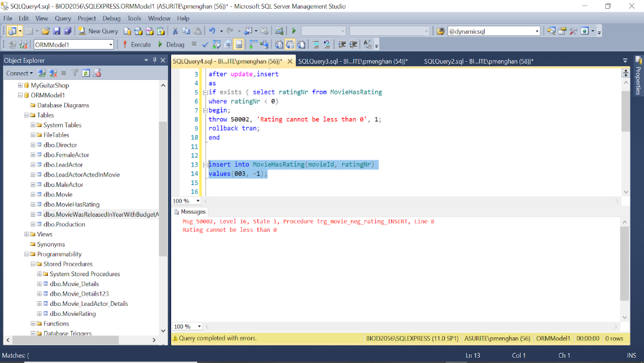
Trigger 2 : tgr_movie_neg_rating_INSERT

Slide 19
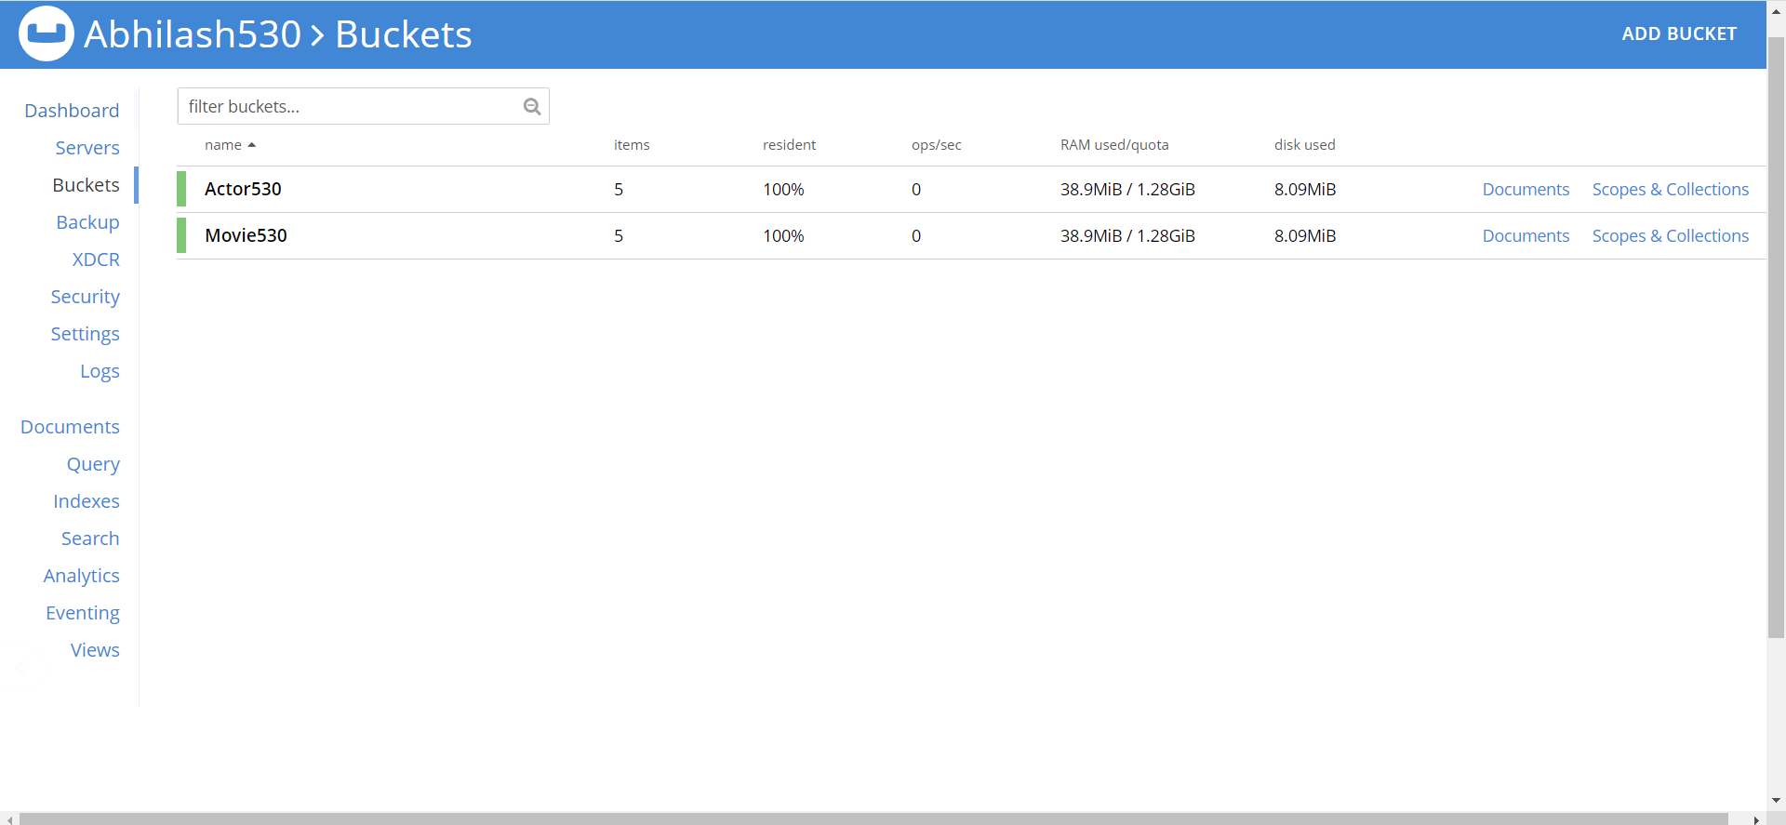
NOSQL
We have created 2 buckets namely:
Actor530
Movie 530
Abhilash

Slide 20
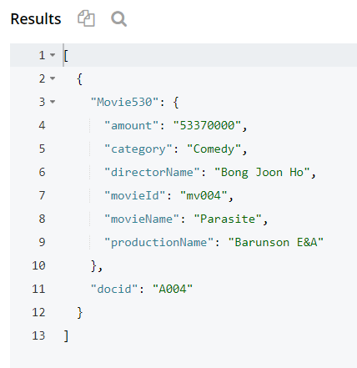
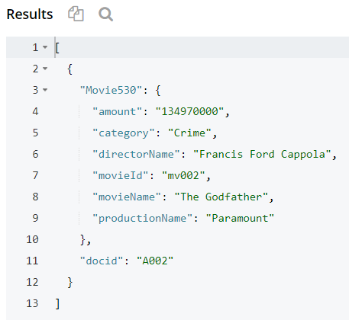
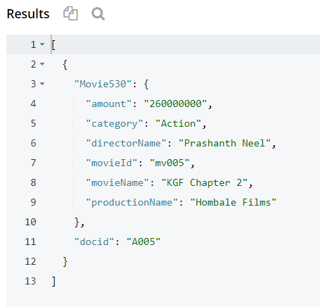
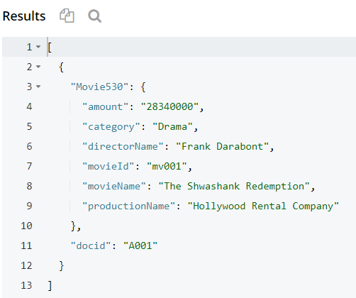
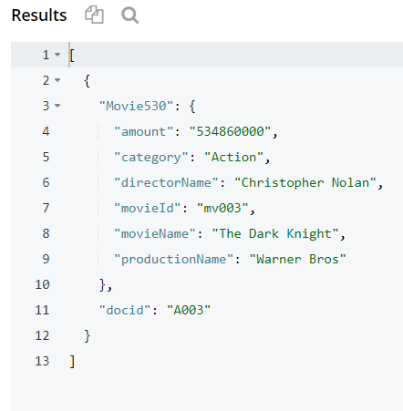
Bucket 1: movie530 We have placed 5 documents in the bucket movie530
Abhilash

Slide 21
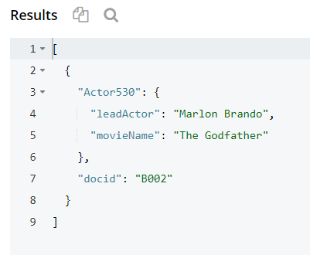
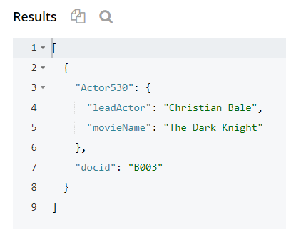
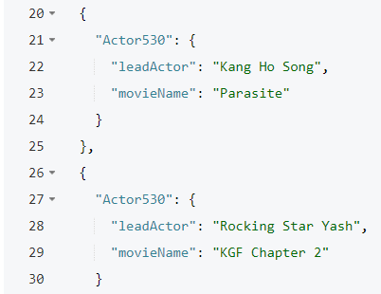
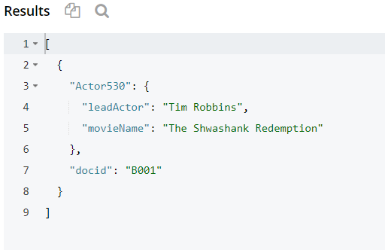
BUCKET 2: actor530
WE HAVE PLACED 4 DOCUMENTS IN THE BUCKET actor530
Abhilash

Slide 22
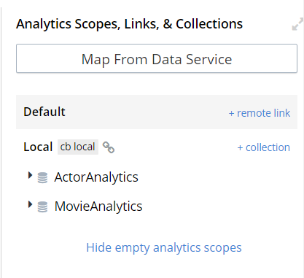
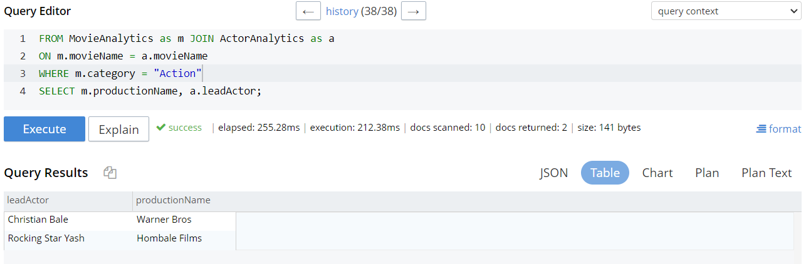
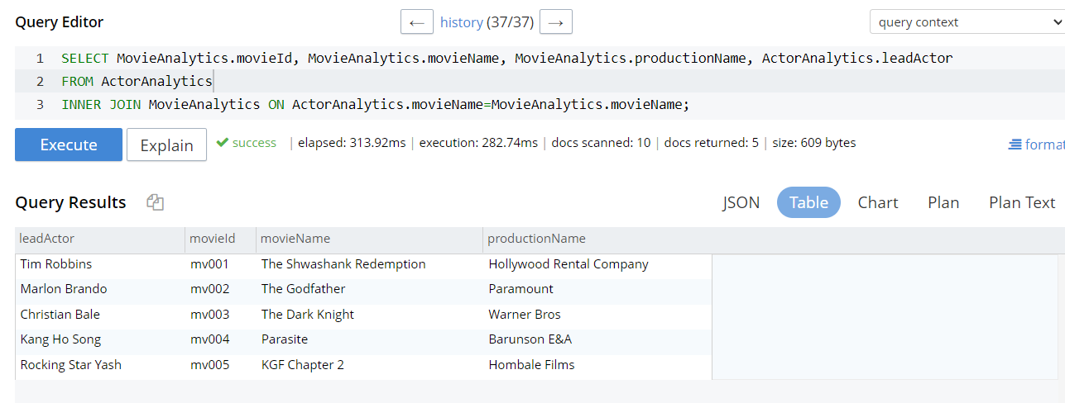
NOSQL
We performed 2 SQL++ queries against those buckets using the Analytics service
Namratha

Slide 23
Summary
We have specified the core data entities and the structure of the database that we propose to construct after completing the initial phase of this project.
This database module is intended to aid a Movie Management company in a variety of areas, including managing movie genres, tracking movie progress, and buying movie tickets.
Apart from the basic stored proc n triggers we implemented , we implemented several users specified functions, stored procedures, and triggers as part of phase 2 of this project to offer other functionality such as ticket availability, best movie, best production and actors, production tenure, and so on.
Namratha

Slide 24
conclusion
Following the development of the initial phase of this project, we saw the relevance of object role modeling and how it can be an exceptionally useful tool for creating databases that bring great levels of convenience to many applications in our daily lives.
We want to reduce data redundancy and improve database connection using our technique. We connected our current database with other ideas presented in class, like as triggers, stored procedures, and user defined functions, to consider the future aspect of this project.
Moving on to the second half of this project, our objective was to add different functions to our model using the ideas of buckets, JSON structures, Couchbase.
Namratha

